Slide 1
The nervous system
Year 11 Biology
Bremer SHS

Slide 2
Warm-up questions
Name the structures used by the circulatory system and describe each of their functions.
Explain why oxygen will move out of blood an in to muscle tissue.
(your answer should use the term concentration gradient)
Explain how the enzyme amylase assists with breaking down starch in to glucose.
(your answer should use the terms substrate, polysaccharide, active site and monosaccharide)
Define the term homeostasis.
Explain the role of the brain in maintaining homeostasis.

Slide 3
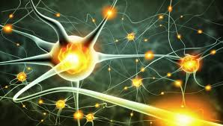
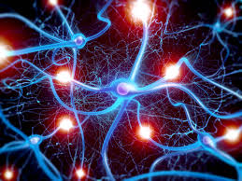
The nervous system
The nervous system is a complex collection of nerves and specialized cells known as neurons that transmit signals between different parts of the body.
The nervous system comprises the central nervous system (CNS) and the peripheral nervous system (PNS).

Slide 4
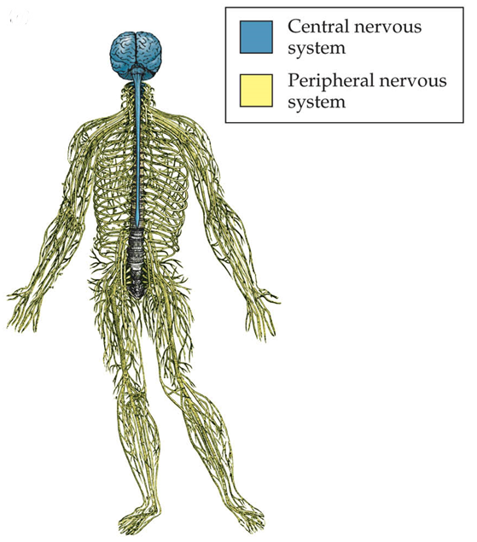
Central nervous system
Integrates information it receives from nerves all over the body then coordinates and influences the activity of all parts of the body.
Components:
Brain
Spinal Cord

Slide 5
Peripheral nervous system
Consists of nerves outside the central nervous system
Connects to the limbs and organs, serving as a communication relay between the brain and spinal cord with the rest of the body
Automatic influences involuntary functions including heart rate, breathing and digestion.
Somatic influences voluntary muscle movements.

Slide 6
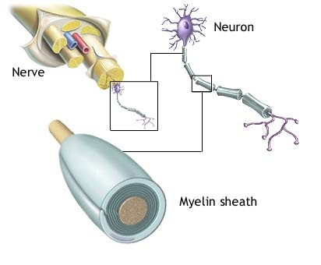
NEURONS
Neurons are the basic cellular unit of the nervous system.
Many neurons together make a nerve fibre.
Bundles of nerve fibres make a nerve.
Each nerve is wrapped in a tube of connective tissue.

Slide 7
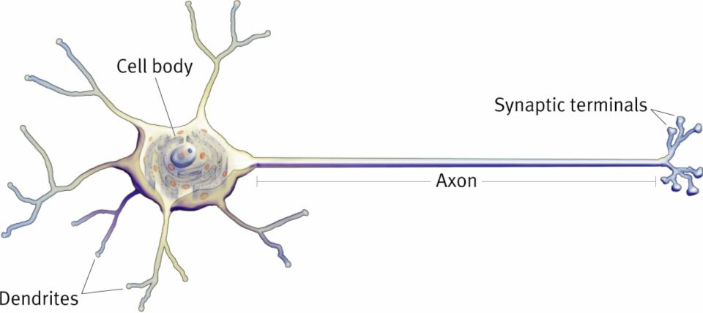
Neuron structure
Dendrites receive messages from other neurons and send them to the cell body
Cell body is the ‘factory’ of the neuron (contains organelles)
Axons carry messages away from the cell body
Synaptic terminals are the contact point with next neuron

Slide 8
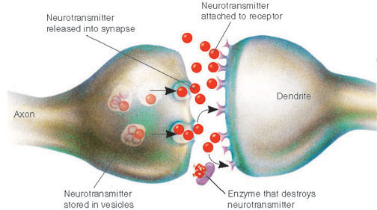
the synapse
Small space across which an impulse moves from an axon to the dendrites or cell body of another neuron.
Impulse reaches end of axon.
Axon releases chemical. (neurotransmitter)
Chemical stimulates the impulse in next dendrite.

Slide 9
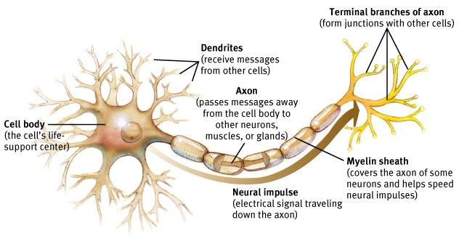
myelination
Myelin is a layer of fatty cells called Schwann cells segmentally encasing the fibers of many neurons.
Enables vastly greater transmission speed of neutral impulses and stops the message from accidently crossing over to a neighbouring neuron.

Slide 10
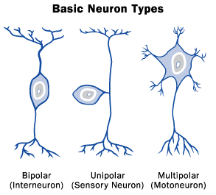
Types of neurons
Sensory neurons
Receive information from receptors and send information to the brain.
Axons can be as long as 1.5m in adults.
Motor neurons
Conduct impulses away from the brain or spinal cord to muscles or glands throughout your body.
Interneurons
Send impulses from sensory neurons to motor neurons.
Primarily located within the brain and spinal cord.

Slide 11
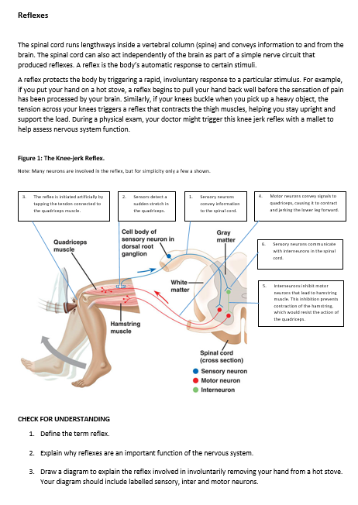
Check for understanding
Read the handout on reflexes and answer the questions at the bottom of the page.

